Slide 1
Understanding encapsulation
Ronnie Holm
Lecture 4

Slide 2

Agenda
Paradigms of thought
Pillars of object orientation
Language constructs supporting encapsulation

Slide 3

Paradigms in astronomy
Paradigm describes distinct concepts or thought patterns
Paradigm shifts are relatively rare
Geocentrism vs. Heliocentrism
Notes:
- Paradigm is a model of reality like classes in a program
- In OO, our view of the world is through classes, but there’re other views as well
- Paradigms exist within any scientific field - Most well known paradigms are probably within astronomy
- Geocentric model
- Earth is the orbital center of all heavenly bodies - Planets orbit in evenly spaced circular orbits - Turned out to be hard to predict heavenly motion - Special cases got added over time, making the model complex - Better telescopes made the imprecisions stand out even further - Even though the model is imprecise, it’s still valuable - Ptolemy’s model dominated for 1500 years until the 17th century - In late 16th century it was gradually superceded by the heliocentric model - Heliocentric model - Earth and planets revolve around a stationary Sun - Planets orbit in elliptical orbits that aren’t evenly spaced - Describes reality better/more precise than geocentric model
- Multiple paradigms usually co-exist for a long time

Slide 4
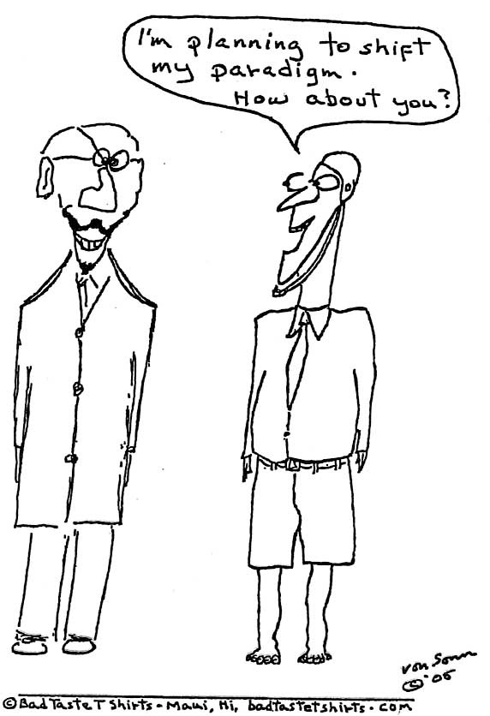
Paradigms in programming
Currently dominating
Structured programming
Object oriented programming
Notes:
- Paradigm shifts happen more frequently in CS than in astronomy
- In CS there’s tens of paradigms, but currently only two mainstream
- SP and OOP have co-existed for 30-40 years
- OO is a successor/superset of SP
- OO contenders include functional programming - Focuses on modelling programs as expressions - Better equiped to deal with concurrency
- OO languages adapt more FP features over time to delay the paradigm shift
- Most people don’t want a paradigm shift because teaching, languages, litterature will need updating
- Key point: OO isn’t the only view on problem solving in software and will eventually get replaced

Slide 5
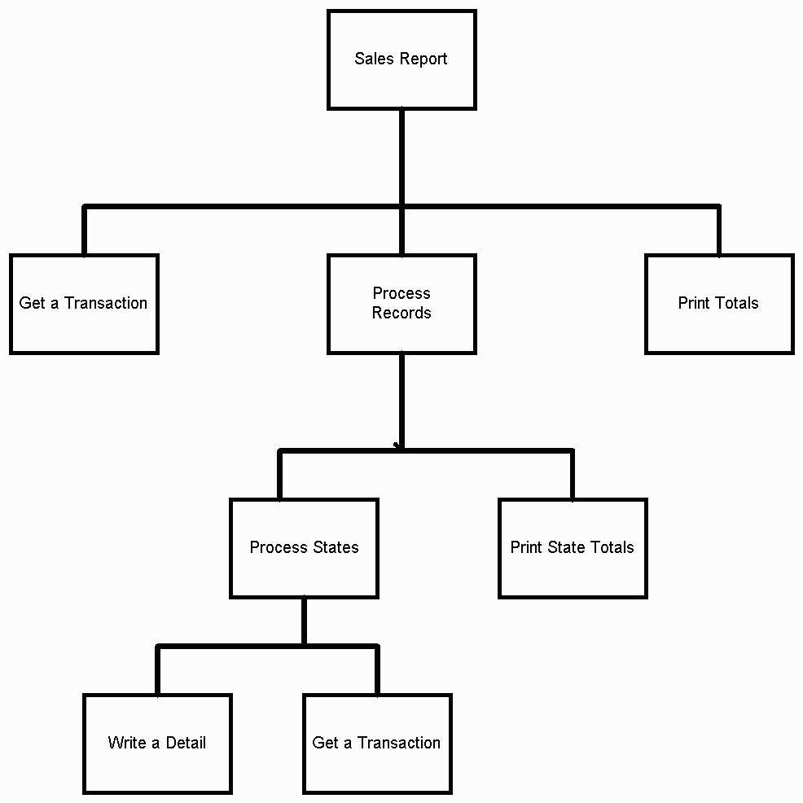
Structured programming
Separates data and routines
Involves global data
Allowing any command to modify any piece of data leads to buggy programs
Reuse is hard when data and routines aren’t tightly coupled
Notes:
- One step up from unstructured spaghetti code full of gotos
- Makes extensive use of block structures such as routines, if statements, and for loops
- Program is seen as a list of tasks to perform
- It’s possible to do SP in almost any language
- In C# terms, think of SP as one class with fields and methods
- Global data would be fields, maybe grouped together in a ”struct”, if supported - Linux and Windows kernels developed using SP, so it’s possible but requires skilled developers
- How to enforce data contrains in SP when multiple methods modify it?
- Maybe take a convention-based approach to OO-immitation with function prefixes
- Conventions easily fall over with thousands of functions calling each other
- Hard to reuse data without the routines because data doesn’t do anything by itself
- Hard to reuse routines when they maybe tied to multiple and independent pieces of data
- Tie into paradigm shift - SP not good at modelling complexity of real-world apps without too many hoops

Slide 6

Object oriented programming
Concept as object
Objects encapsulate
Data (nouns)
Methods (verbs)
Objects are usually instances of classes
Objects are self-contained ”machines” with roles and responsibilities
Notes:
- Establish OO as a superset of SP
- Each object is capable of receiving messages, processing data, and sending messages to other objects
- OO data structures tend to carry their own operators around with them
- Program might contain multiple copies of each type of object
- Objects wrap their data within a set of functions designed to ensure data is used appropriately

Slide 7
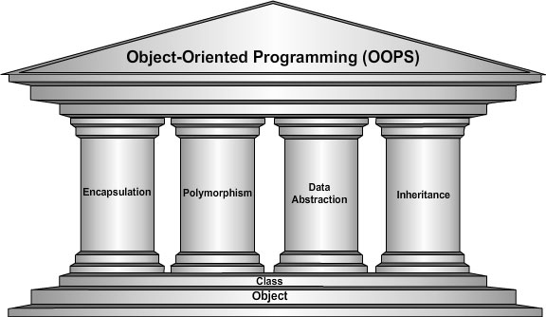
Pillars of OOP
Notes:
- OO may be partially simulated in non-OO languages
- C doesn’t support inheritance, for instance
- Only languages that support all four pillars are real OO languages
- Sometimes data abstraction is absorbed into other pillars

Slide 8
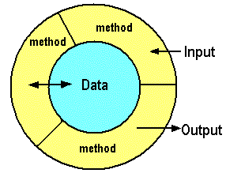
Encapsulation
Keep each class self-contained
Public interface vs. private implementation
Changing public interface means notifying clients
Internal details known only to class
Notes:
- Change implementation details of one class without affecting any other class
- Public interface and pre- and postconditions
- Methods act as intermediaries for retrieving or modifying the data they control
- Methods will typically include safeguards specific to the types of contained data
- Sinus method: Provide angle as argument - Internally have a table of lookup-values or actual formula

Slide 9
Inheritance
Derived types inherit methods/data from parent
Enables reuse of data and code
”is-a” vs ”has-a” relationships
Control
Car
Button
ListBox
GridView
Wheel
Engine
LinkButton
Notes:
- Often confused as a way to reuse existing code which is not a good practice
- Control data: color, size location
- Control methods: draw
- Inheritance for implementation reuse leads to tight coupling - You can only re-use by re-using class hierarchy upwards
- Classes vs. interfaces
- Re-usability of code is better achieved through composition - Interfaces allow composition to support polymorphic behavior - Class can only inherit from one type, but can implement many interfaces - Business-domain classes may all be base classes without any inheritance at all

Slide 10
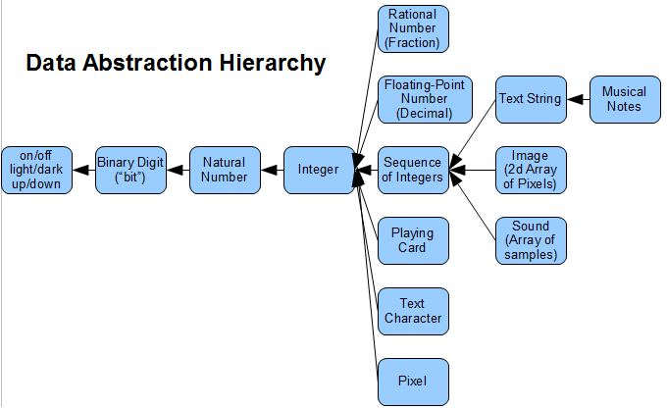
Data abstraction
Reduce details so programmer can focus on a few concepts at a time
Notes:
- Abstraction captures only those details about object that are relevant to current perspective
- Object is an attempt to combine abstractions of data and code
- Allows handling data bits in meaningful ways, i.e., it’s the basic motivation behind a data type

Slide 11
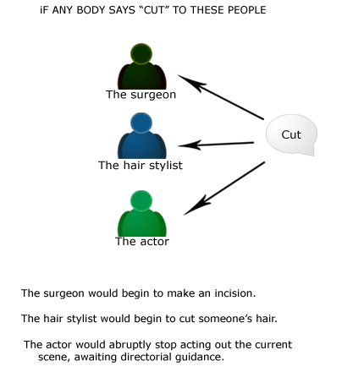
Polymorphism
No need to know specific type as long as type inherits shared ability

Slide 12
Polymorphism (2)
Allows values of different data types to be handled using a uniform interface
Control
Button
ListBox
class Control {
public virtual void Draw() {
Console.WriteLine("Control");
}
}
class Button : Control {
public override void Draw() {
base.Draw();
Console.WriteLine("Button");
}
}
class TextBox : Control {
public override void Draw() {
Console.WriteLine("TextBox");
}
}
class Program {
static void Main(string[] args) {
Control[] controls = {
new Button(),
new TextBox()
};
foreach (Control c in controls) {
c.Draw();
}
}
}
Output
Control
Button
TextBox
Notes:
- Each individual control does the right thing according to its specific type
- In TextBox I don’t call base method
- Virtual vs abstract methods

Slide 13
Constructor
Method(s) that create instances of class
Called implicitly through new keyword
class Car {
string _make;
int _currentSpeed;
public Car() {
}
public Car(string make) {
_make = make;
}
public void SpeedUp(int delta) {
_currentSpeed += delta;
}
}
class Program {
static void Main(string[] args) {
Car c1 = new Car();
Car c2 = new Car("Kia");
c2.SpeedUp(10);
}
}
Notes:
- Ctor’s return type is implicit. Chicken and egg problem
- Ctor is always named by name of class
- If you don’t provide a ctor, a default is provided for you (see ILSply)
- Default ctor takes no arguments - Data is set to default value as part of object construction and before ctor executes - bool is false, ref is null, int is 0, float is 0.0
- Provide your own ctor to set state at construction time
- Naming convenion with _ to avoid scope ambiguity

Slide 14
this keyword
Provides explicit access to instance data
this keyword is implicitly implied
Used for constructor chaining as well
class Car {
string make;
int currentSpeed;
public Car() {
}
public Car(string make) {
this.make = make;
}
public void SpeedUp(int delta) {
this.currentSpeed += delta;
}
}
Notes:
- this resolves ambiguity with member resolution
- Example: with this.make, it resolves ambiguity. For Speedup method it doesn’t add anything
- I hardly ever use this as it adds noise to the code
- this is also useful with constructor chaining
- Use optional arguments with ctor as alternative to ctor chaining for .NET version >= 4.0

Slide 15
Access modifiers
Controls visibility of types and members to other types, members, and assemblies
Make encapsulation possible
Common modifiers
public
private
protected
// internal class with private constructor
class Radio {
Radio() {
}
}
// public class with public constructor
public class Radio {
public Radio() {
}
}
// protected member accessible in derived class
public class Radio {
string _model;
public string GetModel() { return _model; }
protected void SetModel(string model) {
_model = model; }
}
public class DABRadio : Radio {
public DABRadio() {
SetModel("DAB");
}
}
Notes:
- Without access modifiers, encapsulation wouldn’t be achivable and we’d only have OO as a grouping mechanism
- Example - Types are internal by default - Type members are private by default

Slide 16
Properties
Short-hand accessor and mutator methods
Supports read-only or write-only properties
Automatic properties removes boilerplate
Automatic properties always implement both read and write
public class Person {
string _name;
public string GetName() {
return _name; }
public void SetName(string name) {
_name = name; }
}
public class Person {
string _name;
public string Name {
get { return _name; }
set { _name = value; }
}
}
public class Person {
public string Name { get; set; }
}
Notes:
- Implemented as accessor and mutator methods in CIL (verify with ILSpy)
- Removes boilerplate code as many properties has no associated logic
- value within mutator is a special token provided by the compiler
- Oftentimes validation logic is added to set
- Name of backing field is invalid from C# but valid in CIL (prevents conflicts with C# code)
- Start with simple properties, then expand to hand-written ones when needed

Slide 17
Object initialization syntax
Class may not provide constructor to set value of all public fields or properties
Short-hand way to set values
public class Person {
public string Firstname { get; set; }
public string Lastname { get; set; }
}
class Program {
static void Main(string[] args) {
Person p = new Person();
p.Firstname = "John";
p.Lastname = "Doe";
}
}
class Program {
static void Main(string[] args) {
Person p = new Person {
Firstname = "John",
Lastname = "Doe"
};
}
}
Notes:
- Removes boilerplate code
- Example - Default ctor is called, then the setter for each property
- Can be used with custom ctor as well

